Slide 1
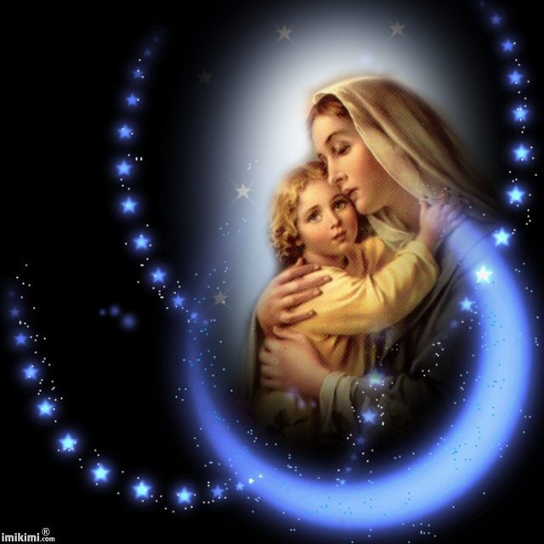
I praise the Virgin:
And explain and say:
O, the origin:
And the hidden Pearl:

Slide 2
Through your Son,
our Lady:
Cause of salvation:
We reached the goal:
And you brought us joy.

Slide 3
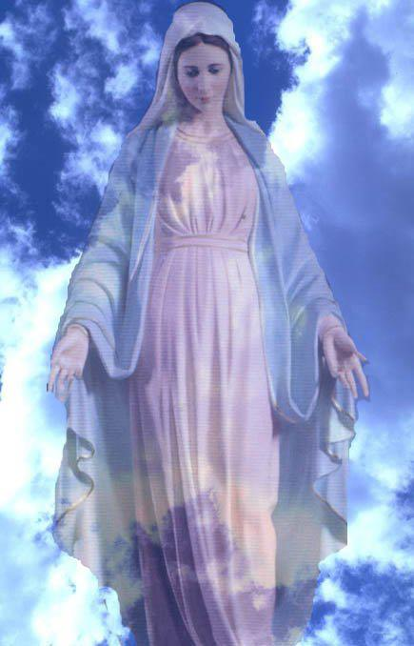
Was truly Incarnate
From a Virgin girl
Crucified and died
For us at Golgotha

Slide 4
The fruit of my pledge
O, daughter of Zion
To love your Son
And proclaim and say

Slide 5
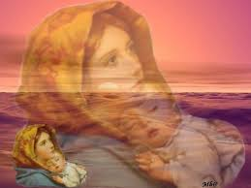
Gabriel came:
With tidings and sayings:
You accepted his word:
In calmness and wisdom:

Slide 6
He dwelt by His Word:
In strength and power:
You became like heaven:
O, daughter of Zion.

Slide 7
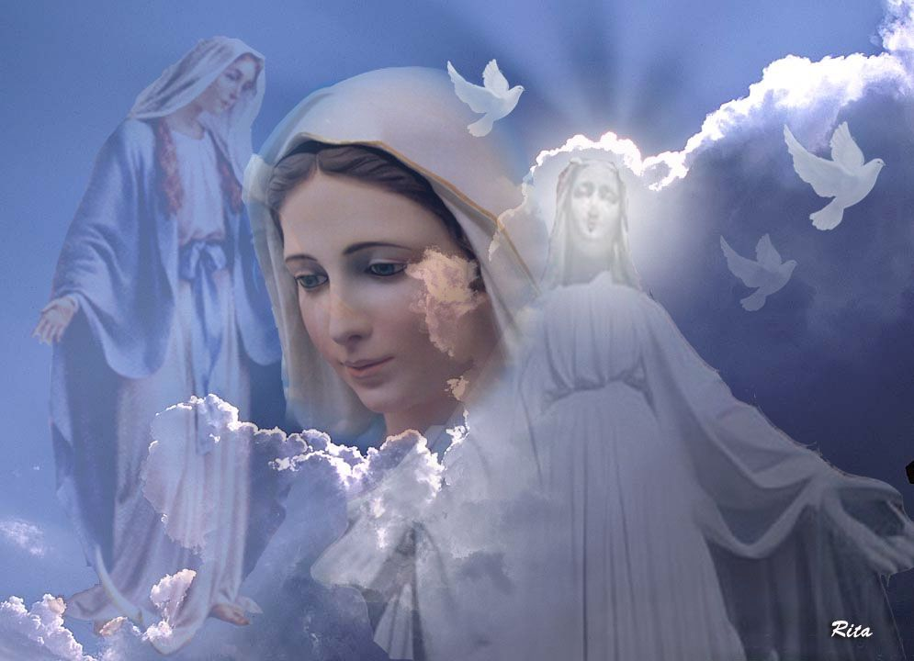
Your love embraced me:
O pride of nations:
Moses have seen you:
Surprise and marvel:

Slide 8
And the lamps are bright:
With golden crosses:
O Mary, Moses’ dome:
O Aaron's censer.

Slide 9
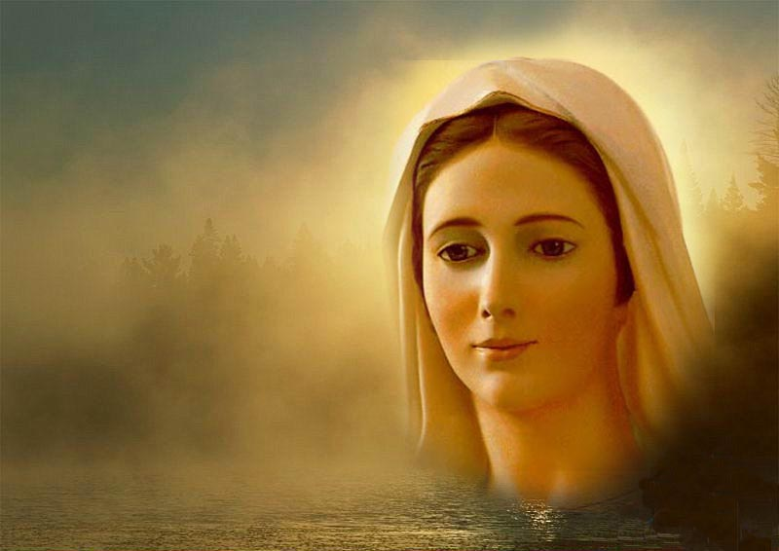
He saved Adam:
After his sorrow:
And has freed the world:
We rejoice in you:

Slide 10
He is glorified:
And promised His Apostles:
To save His people:
From Satan's bondage.

